Slide 1

Predict Protein Dynamics for Drug Desing

Slide 2


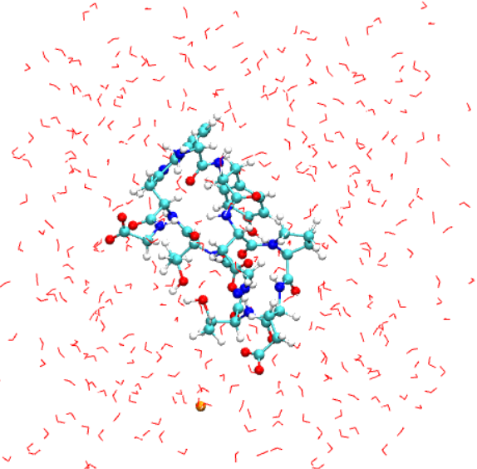
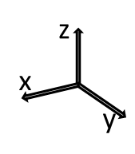
Molecular dynamic simulations
in molecular biology and drug discovery, uncovering the structural basis for disease
Molecular dynamics simulations (MD) are computational methods that capture and analyze the physical behavior of proteins and other biomolecules in high temporal resolution.
MDs simulates the time-dependent behaviour of an ensemble of atoms by solving Newton’s equations of motion for each atom.
Starting from a given position of each atom of a biomolecular system, a crystallographic structure surrounded by water or lipidic membrane, we calculated the force associated to each atom.
MDs aim: mimicking what biologycal systems do in real life at atomistic level
t
2fs
At the end we have a trajectory, which can be considered as a movie that simulate the conformational behavior of the system at atomic level
Every 2 femtoseconds the forces acting on each atom are computed and the positions and velocities updated.

Slide 3
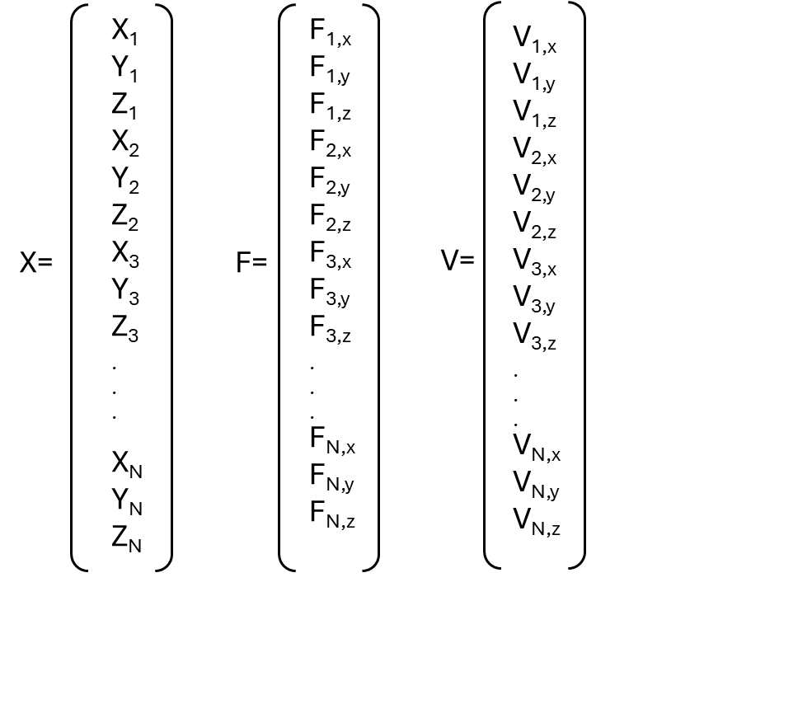
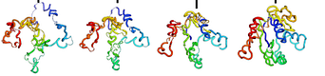
t₀
t₁
t_{n}
3 matrices (X,V,F) for each timne step
…
Time dependent prediction of force, velocity and coordinates matrices to update positions and accelerate molecular dynamic simulations
t₀
t_{n}
Starting geometry
Δt

Slide 4

A single vector F specifies the force acting on every atom in the system. This vector lists the force on each atom in the x-, y-, and z- directions
Coordinates (crystallographic structure)
$$Fi=−\overline{V }ri U (\left\{r\right\})$$
Force on atom i is given by derivatives of U (total potential energy) with respect to the atom’s coordinates xi, yi, and zi
X₁
Y₁
Z₁
X₂
Y₂
Z₂
X₃
Y₃
Z₃
.
.
.
X_{N}
Y_{N}
Z_{N}
F_{1,x}
F_{1,y}
F_{1,z}
F_{2,x}
F_{2,y}
F_{2,z}
F_{3,x}
F_{3,y}
F_{3,z}
.
.
.
F_{N,x}
F_{N,y}
F_{N,z}
V_{1,x}
V_{1,y}
V_{1,z}
V_{2,x}
V_{2,y}
V_{2,z}
V_{3,x}
V_{3,y}
V_{3,z}
.
.
.
V_{N,x}
V_{N,y}
V_{N,z}
Velocities and forces for each atom give us the direction of the movement, attraction or repulsion.
vᵢ(t+Δt/2) = vᵢ(t−Δt/2) + [Fᵢ(t)/mᵢ]Δt
V=
leap-frog integrator to upload the velocities after the Force calculation
X=
F=
In the trajectory file (.trr), for each time-step we have 3 matrices of lenght 3N in binary format
Coordinates (X)
Forces (F)
Velocities (V)

Slide 5
Challenges:
Deal with dimensionality reduction!
Find the shorter time window which yields to the best predictions!
Enable Super Resolution!
Explain Predictions using attention maps!

